Slide 1
Logistical notes
Please come up and pick up your graded midterm 2 (and/or corrections to midterm 1…) if you haven’t already!
Srsly pls I don’t want to hang on to your tests… you need them to study!
Tuesday after the break, 11/27, will be a TCO night if clear!
Happy holiday break! The deadline extension fairy has visited MasteringAstronomy and removed late penalties on Lab 5, Lab 6, and Chapter 20! Rest, eat something tasty, and catch up on homeworks.

Slide 2
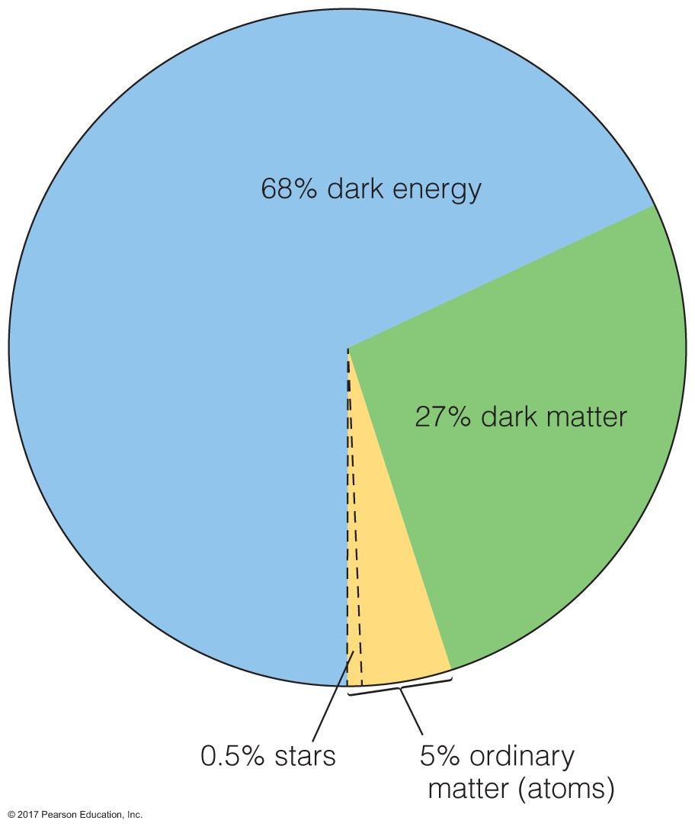
Accelerating universe?
Acceleration discovered in 1998
Nobel prize for discovery in 2011
Acceleration must mean there’s some force driving expansion: dark energy!
Notes:
E=mc^2 shows up again.. The missing mass we haven’t been able to account for could be not mass, but rather, energy!

Slide 3
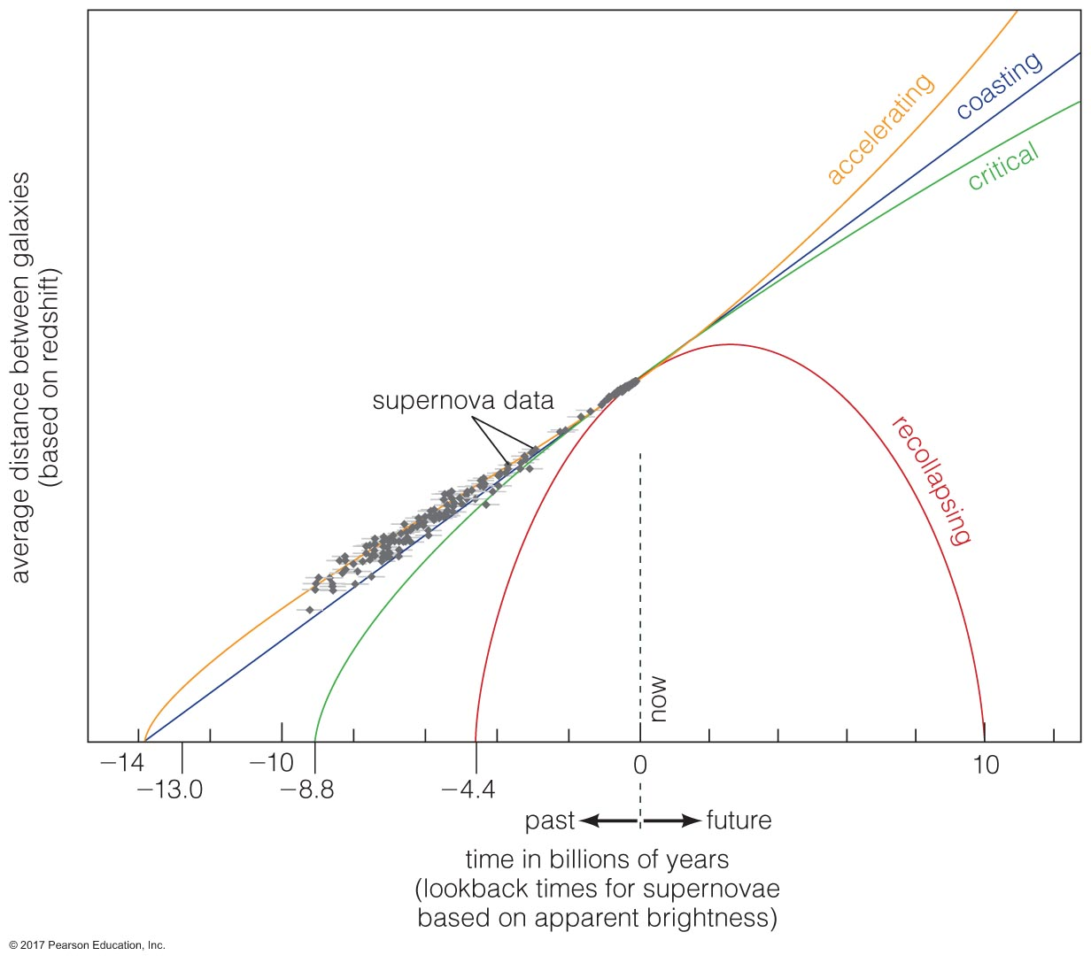
The fate of the universe

Slide 4
Life in the universe
Chapters 13 and 24. The Cosmic Perspective
Notes:
https://medium.com/science-uncovered/science-fiction-vs-reality-a-look-at-exoplanets-b5e250bebd95

Slide 5
Life in the Universe
Switching gears from the heat death of the universe… let’s talk about life
Is there life in the universe, other than us?
What are the conditions necessary for life?
Where do we look for it?
…why haven’t we found it yet?
Notes:
Today’s lecture has a lot of question marks. Remember how I said each chapter was getting slimmer because we know less and less about the topics? Yeah, this is the ultimate don’t know- life in the universe

Slide 6
Life in our solar system?
Evidence of extremophiles on Earth expand our view of what “supporting life” might mean
Live in extreme heat, acidity, dryness
Planets in our solar system that may have supported life:
Mars:
evidence for liquid water in the past
current water ice
methane gas in its atmosphere that we don’t know
the origin of
potentially liquid water in the interior
maybe we’ll find Martian fossils someday
Notes:
Image from https://www.space.com/41329-mars-closest-to-earth-2018.html

Slide 7
Today in science…
Chilean Atacama desert thought to have been hyperarid for the past 15 million years
In places, no rain recorded for past ~500 years
Microbiome has adapted to arid conditions: about 16 known microbial species in soil
Until…
Rain! ”Freak weather event” left pools of water in normally hyperarid region
Only 2-4 microbial species left
Area thought of as proxy for Mars
Maybe Mars’ life was wiped out by water, rather than
supported
Must carefully consider what we think is necessary for life
in the universe
Notes:
Theme of class today: life in the universe!
https://www.sciencealert.com/when-rainfall-kissed-the-driest-desert-on-earth-it-was-literally-the-kiss-of-death

Slide 8
Life in our solar system?
Moons in our solar system that could support life
Jupiter:
Europa
Tidal heating would make interior liquid ocean
Hot volcanic vents at bottom of interior sea
So promising, scientists wondering why there wouldn’t be life after 4.5 billion years
Ganymede & Callisto
Also have potential for sub-surface liquid oceans
But, lower tidal forces; less energy. Maybe smaller life forms
Notes:
https://phys.org/news/2018-05-evidence-plumes-jupiter-moon-europa.html
https://earthsky.org/space/million-fold-chorus-waves-detected-on-jupiters-moon-Ganymede

Slide 9
Life in our solar system?
Moons in our solar system that could support life
Saturn:
Titan
Cold, mostly N atmosphere, but atmosphere would protect from radiation/cosmic rays
Surface can support liquid methane and ethane lakes, not water
Low gravity + atmosphere = we could fly if wearing wings! Spiffy
Enceladus
Ice fountains and liquid sub-surface water
Could possibly live there if we dug down enough
Notes:
https://www.npr.org/sections/13.7/2017/10/16/555045041/confession-of-a-planetary-scientist-i-do-not-want-to-live-on-mars
http://www.planetary.org/blogs/emily-lakdawalla/2015/04081101-a-moon-with-atmosphere.html
https://solarsystem.nasa.gov/missions/cassini/science/enceladus/

Slide 10
Team Saturn’s Moons
And that view, right?
Notes:
https://thewallpaper.co/hd-space-wallpapers-galaxy-high-definition-desktop-images-download-iphone-wallpapers-astro-amazing-2200x1197/

Slide 11
Team Jupiter’s Moons
Hm, or…

Slide 12
Which planet would you want to live on the moon of?
Jupiter
Saturn
Notes:
Those are the best candidates for life as we know it in our own solar system; they have enough internal energy from tidal forces of their planets/neighboring moons squeezing them to have liquid water under their icy crusts. Or, decent enough pressure and atmospheric blanketing conditions to support life that has sufficient temperature/breathing apparatus

Slide 13
Life outside our solar system?
SETI: Search for Extra-Terrestrial Intelligence
Typically done with radio waves, since that’s how we’ve largely communicated for decades
Radio waves from our shows in the 1950s may now be ~60 light years from Earth, though much weaker than our own current technology could detect
In 1974, we attempted a high-powered blast of radio into space toward the globular cluster M13
25,000ly from Earth – will take 25,000 years to get there, and another 25,000 ly for any response to get back
If we don’t know about life in our own solar system, how can we know about other civilizations in the galaxy/universe?
Notes:
Why might we have picked a globular cluster to beam this signal at?

Slide 14
Life outside our solar system?
SETI: Search for Extra-Terrestrial Intelligence
If we don’t know about life in our own solar system, how can we know about other civilizations in the galaxy/universe?
Well, let’s think about the options/odds… astronomer Frank Drake made an equation for this:
# Civilizations = N_{HP} * f_{life} * f_{civ} * f_{now}
N_{HP} = # of Habitable Planets
f_{life} = fraction of planets that could have life
f_{civ} = fraction of planets with life where civilization capable of communication could develop
f_{now} = how many of those planets have civilizations now
Notes:
Right now, we can only figure out with decent accuracy how many habitable planets there might be in the galaxy, and even that one is tough.

Slide 15
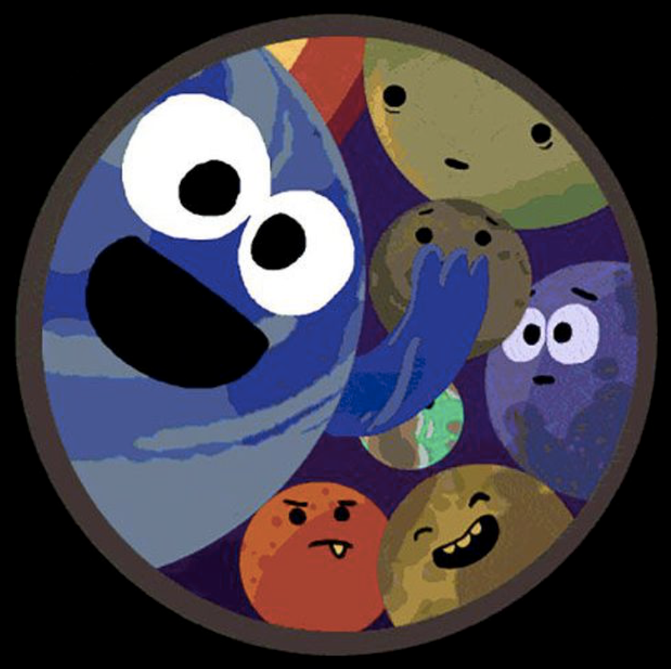
Life outside our solar system?
Exoplanets seem like a really good place to start looking for extra-solar life! We look for planets that could be habitable. Based on Earth, this requires:
A distance far enough from host star for water to be liquid
Volcanism to release internal gases to fill planet’s atmosphere and oceans
Plate tectonics for CO₂ cycle to regulate climate
A magnetic field to shield from harmful energetic particles in stellar wind
Search for exoplanets began around solar-mass stars (or lower) because
Massive stars rare
Massive stars have shorter lifetimes
More observational issues to be discussed…

Slide 16

Exoplanets!

Slide 17
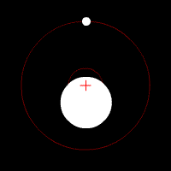
Detecting exoplanets
Many methods for detection
Astrometric
Star, planet move around system center of mass
Can detect motion of star around in the sky
Limitations:
Star needs to be nearby
Planet needs to be massive
Inclination of system: optimal orientation is face-on (pole-on)
Notes:
https://earthsky.org/space/how-do-astronomers-discover-exoplanets

Slide 18
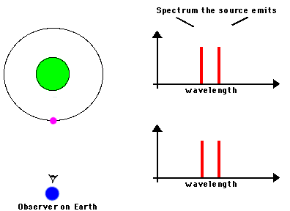
Detecting exoplanets
Many methods for detection
Astrometric
Doppler
Similar to astrometric, but using shift of spectral lines rather than absolute position on the sky
Velocity of star at maximal red/blueshift tells us about
How massive the planet is
Separation of planet and star
Limitations:
Planet needs to be massive enough, close enough
Resolution of spectrograph determines how small a shift can be observed
Need to know mass of star well to get planet mass

Slide 19
Detecting exoplanets
Many methods for detection
Astrometric
Doppler
Transit
Planet passes between us and star along our line of sight
Star+planet (reflected) light, planet blocks some star light, star+planet light, star only
Depth of decrease in light related to planet’s radius
Steepness of light curve shape related to planet radius, sharpness of planet edge (shallower = atmosphere present!)
Length of eclipse related to size of star
Limitations:
Alignment must be such that planet travels into line of sight
Planet must be large enough to block sufficient amount of light
Can only get radius of planet, no mass information

Slide 20
Aside, re: transits
Star surfaces aren’t perfectly smoothly lit! Have spots and active regions!
Notes:
https://wasp-planets.net/2016/09/02/long-lasting-starspots-on-exoplanet-host-qatar-2/

Slide 21
Aside, re: transits
Which stars are the best to look at for planets?
The stars we have the most of
Stars with close-in ”habitable zones”
Stars that are relatively small, so the size of the planet transiting is comparatively large
M dwarfs!
Issues:
Faint!
Active!
Flares
Spots
Effects that make signals confusing
Notes:
Mearth project
https://www.cfa.harvard.edu/MEarth/Welcome.html
https://www.cfa.harvard.edu/MEarth/Discoveries.html
https://astrobiology.nasa.gov/news/where-is-the-habitable-zone-for-m-dwarf-stars/

Slide 22
M dwarf transits
Proving that astronomers have the coolest footwear…
Zach Berta-Thompson at CU Boulder is part of the MEarth project
Using array of small telescopes to do large survey of nearby M dwarfs looking for Earth-like planets
Small budget, big results!
Notes:
http://casa.colorado.edu/~bertathompson/

Slide 23
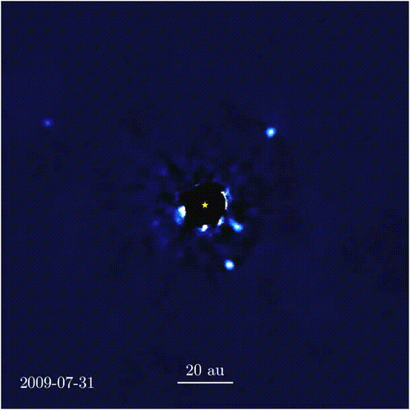
Detecting exoplanets
Many methods for detection
Astrometric
Doppler
Transit
Direct detection
Imaging with coronagraphs in place
Scattered visible light
Infrared thermal emission
Alycia Weinberger, Carnegie/DTM →
Notes:
https://en.wikipedia.org/wiki/Beta_Pictoris_b#/media/File:Beta_Pictoris_system_annotated.jpg
https://en.wikipedia.org/wiki/Fomalhaut_b
http://www.planetary.org/explore/space-topics/exoplanets/direct-imaging.html
https://en.wikipedia.org/wiki/Alycia_J._Weinberger

Slide 24
Detecting exoplanets
Many methods for detection
Astrometric
Doppler
Transit
Direct detection
Microlensing
Gravitational lensing, on small scales
Mass ratio of planet/star, angular separation of planet/star
Allows for detection of low-mass planets
Limitations:
Difficult to find: perfect alignment needed, timing just right
Not repeatable
Planet parameters depend on how well we know host stars (often, not well)
Notes:
http://www.planetary.org/explore/space-topics/exoplanets/microlensing.html
http://hubblesite.org/image/2976
http://www.scholarpedia.org/article/Microlensing_exoplanets

Slide 25
Detecting exoplanets
Many methods for detection
Astrometric
Doppler
Transit
Direct detection
Microlensing
Radio emission
Hasn’t been done yet! But maybe it could be?
Depends on how strong B field is, stellar wind, mass ejections
Aline Vidotto, Trinity College Dublin →
Notes:
Aline made predictions for what the radio emission would be for a planet called Tau Boo, pioneered work to try to detect exoplanetary radio emission
http://herrero-radio-astronomy.blogspot.com/2016/03/coronal-mass-ejection-triggering.html

Slide 26
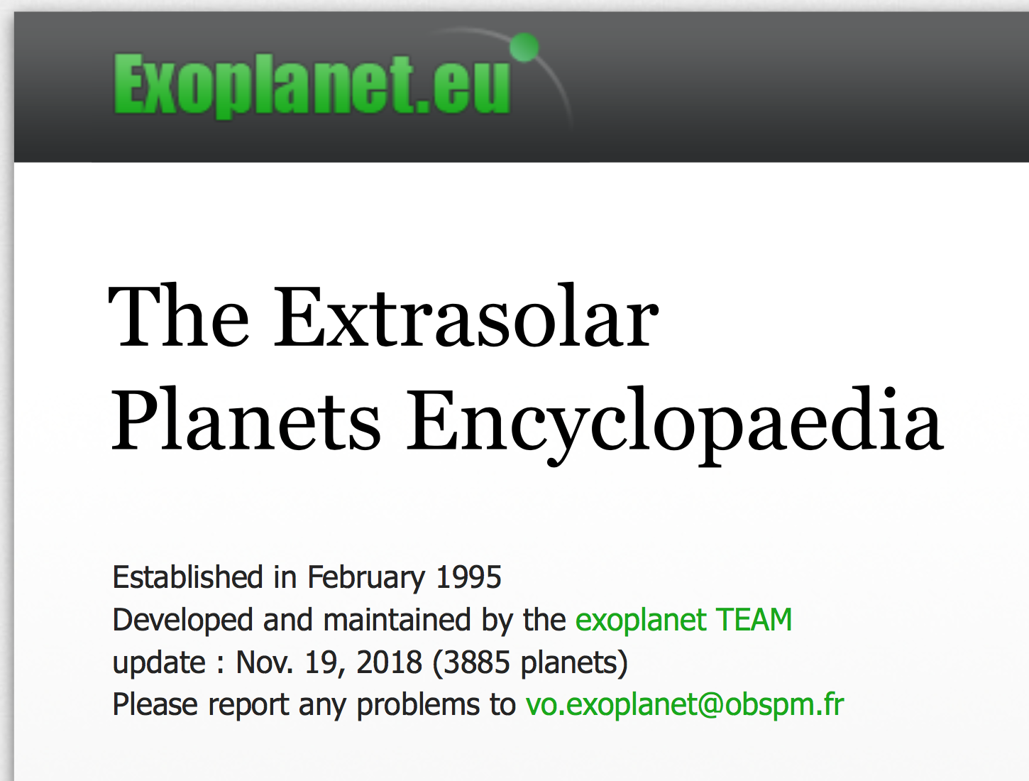
Exoplanet detections
With all of these methods, we have detected, to-date, about … 3900 exoplanets!
Notes:
http://exoplanet.eu

Slide 27
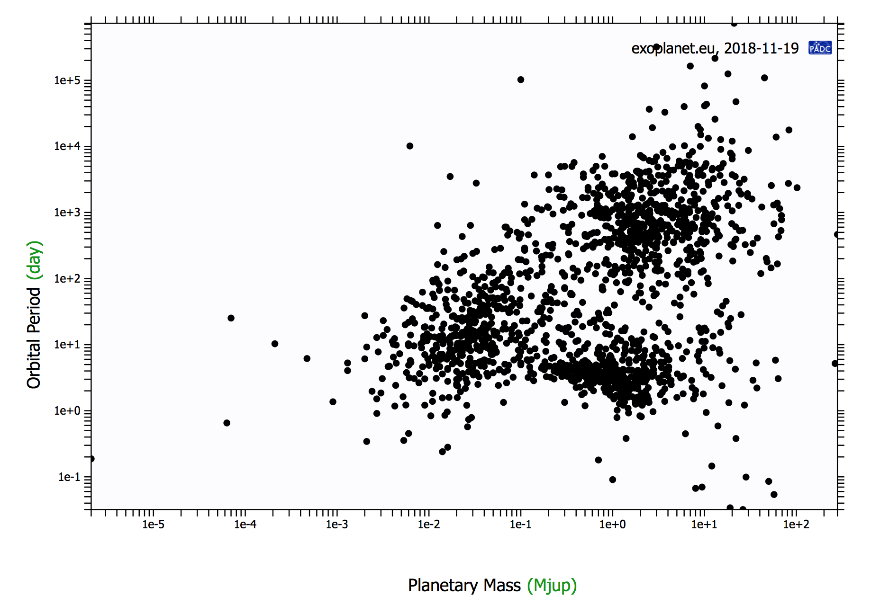
Exoplanets
For reference… masses and orbital periods for our solar system planets:
Jupiter
1 M_{Jup}
4,300 d
Saturn
0.2 M_{Jup}
11,000 d
Neptune
0.05 M_{Jup}
60,200 d
Earth
0.003 M_{Jup}
365 d
Mars
0.0003 M_{jup}
687 d
exoplanet.eu
Notes:
http://exoplanet.eu/diagrams/
Our observations are biased toward higher mass planets and shorter orbital periods

Slide 28
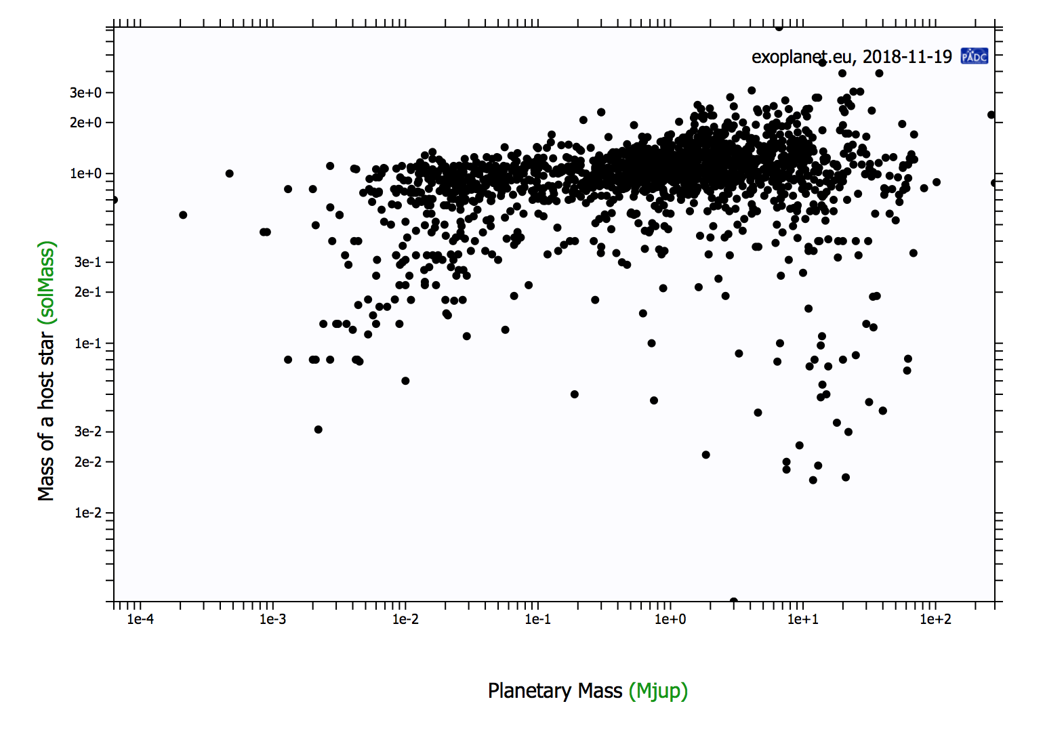
Exoplanets
For reference… masses and orbital periods for our solar system planets:
Jupiter
1 M_{Jup}
4,300 d
Saturn
0.2 M_{Jup}
11,000 d
Neptune
0.05 M_{Jup}
60,200 d
Earth
0.003 M_{Jup}
365 d
Mars
0.0003 M_{jup}
687 d
exoplanet.eu
Notes:
http://exoplanet.eu/diagrams/
Our observations are biased toward higher mass planets and shorter orbital periods
And also stars ~1 Msun.

Slide 29
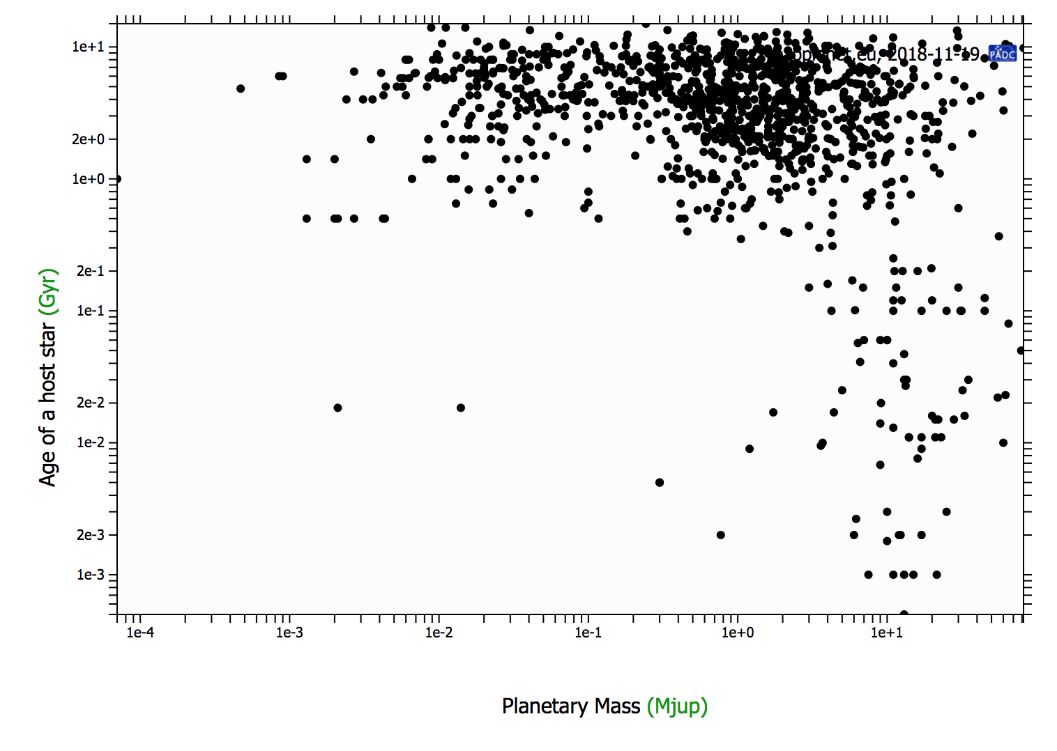
Exoplanets
For reference… masses and orbital periods for our solar system planets:
Jupiter
1 M_{Jup}
4,300 d
Saturn
0.2 M_{Jup}
11,000 d
Neptune
0.05 M_{Jup}
60,200 d
Earth
0.003 M_{Jup}
365 d
Mars
0.0003 M_{jup}
687 d
exoplanet.eu
Notes:
http://exoplanet.eu/diagrams/
Our observations are biased toward higher mass planets and shorter orbital periods
And also stars ~1 Msun.
And also stars >~100Myr, because the gas/dust need to have cleared for us to see the planets. Also, they need to have formed…
Note trappist system planets, GQ Lup system planets

Slide 30
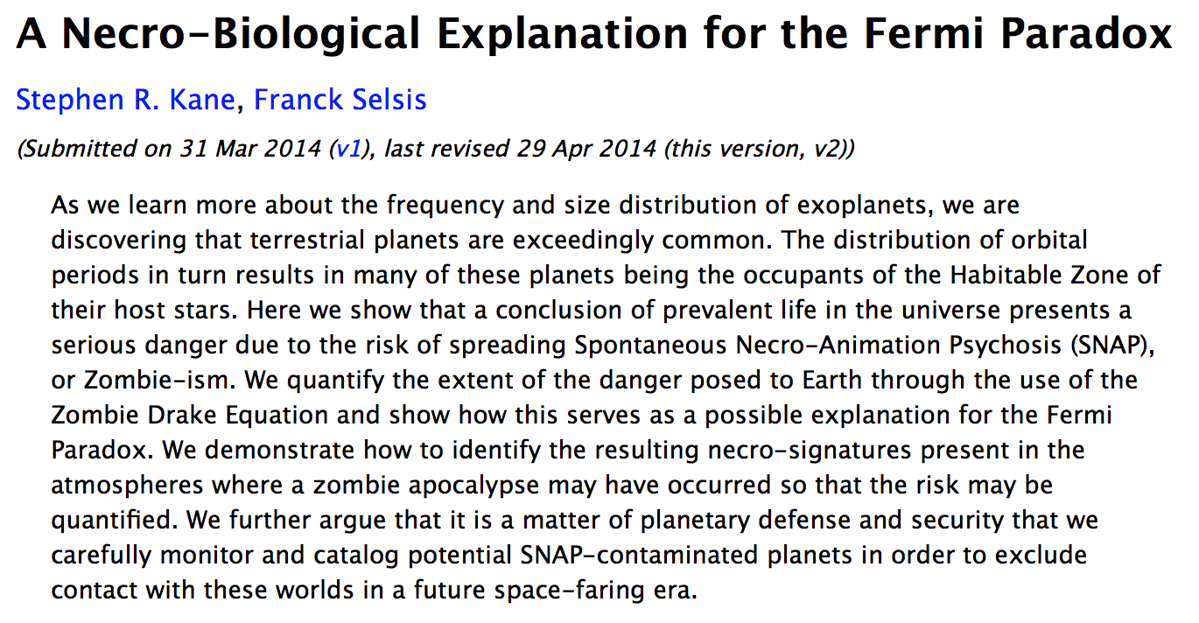
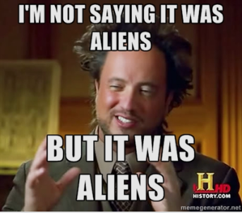
Aliens…?
Where are the aliens?
Detecting exoplanet atmospheres is the new burgeoning science
Water vapor has not yet been detected
Papers have attempted to determine what you’d observe in an exoplanet’s atmosphere, post-zombie apocalypse…
Notes:
It’s a joke.. https://arxiv.org/abs/1403.8146
April fool’s day on the arxiv is a good day.

Slide 31
Aliens…?
The Fermi paradox: Plausible arguments suggest another civilization should exist in our galaxy, but we haven’t found it yet. Fermi famously said,
“So where is everybody?”
If we could travel at ~a few percent c, within a few centuries, we could have outposts at the nearest stars
In 10,000 years, we could have many outposts within a few 100 ly of Earth
Spreading out from those outposts, in 1,000,000 years, we could have a galaxy-spanning civilization
The Milky Way is about 13.5 billion years old; generations of stars coming before us could have had civilizations that were able to do this already, billions of years before us
What if we aren’t the only ones?

Slide 32
Aliens…?
Say the odds of a civilization like ours developing around any given star in the Milky Way is 1 in 1,000,000
Estimate 100 billion stars in the Milky Way, that means 100,000 civilizations in our Milky Way, one arising roughly every 50,000 years or so
The next-youngest civilization to ours would be 50,000 years ahead of us, most would be even more, up to billions of years ahead of us
Recall last slide: to make galactic outposts across entire MW would take ~1,000,000 years
“So where is everybody?”

Slide 33
Are we alone?
Maybe civilizations are extremely rare
Maybe our original estimate was really low- instead of 1 in 1,000,000; maybe the odds are more like 1 in 100 billion
That could imply we’re the first in the MW, maybe the universe
No pressure, humans
If this is true, our existence is remarkable
We would be the first in the universe to be self-aware
Humanity’s existence would be all the more precious, and…
Our self-driven path to demise all the more tragic

Slide 34
Are we alone?
Ok, scratch that sad one. Let’s say civilizations are common, but spreading out throughout the galaxy isn’t. Why not?
Space travel hard! Expensive!
Maybe the urge to travel is unusual and unique to us
Orrr maybe civilizations have existed, but .. Um. Destroyed themselves already.
This option is a bummer for us: if countless other MW civilizations have tried space travel and not succeeded before imploding, it’s not a hopeful scenario.
Notes:
Dang it I was trying to steer toward uplifting…

Slide 35
Are we alone?
Ok, that was a bummer, too. Option 3: there IS a galactic civilization, but it hasn’t yet revealed its existence to us.
Maybe we’re n00bs to the galactic scene and they’re deliberately waiting until the time is right to say hey
Maybe they’re messing with us, like some Earth-sized Truman Show
(I mean, it explains the Bermuda Triangle, anyway)
A large portion of the choice, at this point, appears to be ours:
Do we develop technology to take us to the stars, or,
Do we self-destruct before we can get there?
Notes:
Well, ok, not all of us; just some of us.

Slide 37
Challenges of space travel
Our fastest Voyagers (Pioneer 10 & 11, Voyager I & II, New Horizons) are traveling as fast as anything built by humans
0.00001c
Would take 100,000 years to reach Proxima Cen
Need to get closer to c to make travel to nearby stars feasible
Enterprise would need 2000x entirety of Earth’s annual energy usage to go 0.5c
Need new kind of engines
Need new kind of shielding from high-energy cosmic rays (due to speed of craft’s motion!)
Probably need one-way tickets: everyone on Earth would age 50 years for the two years spent traveling 50 light-years near c

Slide 38
Clicker free response:
History of astronomy
Scientific method
Phases of the Moon
Seasons/the celestial sphere
Physics
Conservation laws
Properties of light
Properties of matter
Kepler’s laws
Newton’s laws
Thermal radiation (Wien’s law and Planck’s law)
Telescopes
The Sun
Structure
Fusion
Activity
Stars
Surveying stars (clusters, H-R diagram)
Formation
evolution
after the main sequence
Galaxies
The Milky Way
Structure of galaxies
evolution
Cosmology:
Hubble’s law
Evidence of the Big Bang
Evolution of the universe
Fate of the universe
Exoplanets
What would you most like me to review next class before the final exam? Which topic this semester was the most challenging for you?
This semester, we studied… →

Slide 39
Wanderers
Why do we even ask why?
Why do we even consider life in the universe?
Notes:
Movie tiiiime…

